Slide 1




PROJECT on
Grocery Store Management System
Presented by: lokeswarreddy

Slide 2

Agenda
Grocery Store Management System
Introduction
Objectives
Data Description
ER Diagram
DDL - Creating Table Structures
DML - Inserting Data into Tables
Quick Overview of the Data
DQL - Analytical Insights
Customer Insights
Product Performance
Sales and Order Trends
Supplier Contribution
Employee Performance
Order Details Deep Dive

Slide 3
Introduction
The Retail and Grocery domain involves the management of inventory, suppliers, customer orders, employees, and product categories. Effective data management in this domain allows businesses to:
Track sales and revenue
Monitor product availability
Analyze customer and employee activity
Improve operational efficiency
This project simulates a mini grocery store database where various entities such as products, suppliers, customers, and orders interact.

Slide 4
Objectives
The main goals of this SQL project are :
To design and implement a relational database for a grocery store.
To retrieve and manipulate data using SQL queries.
To perform data analysis for business insights such as top customers, best-selling products, and revenue trends.

Slide 5
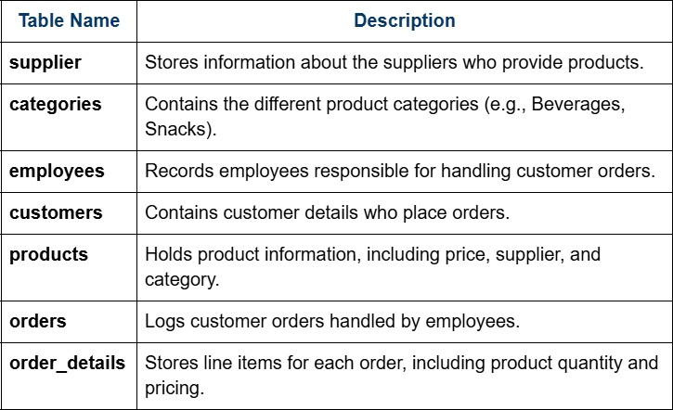
Data Description

Slide 6
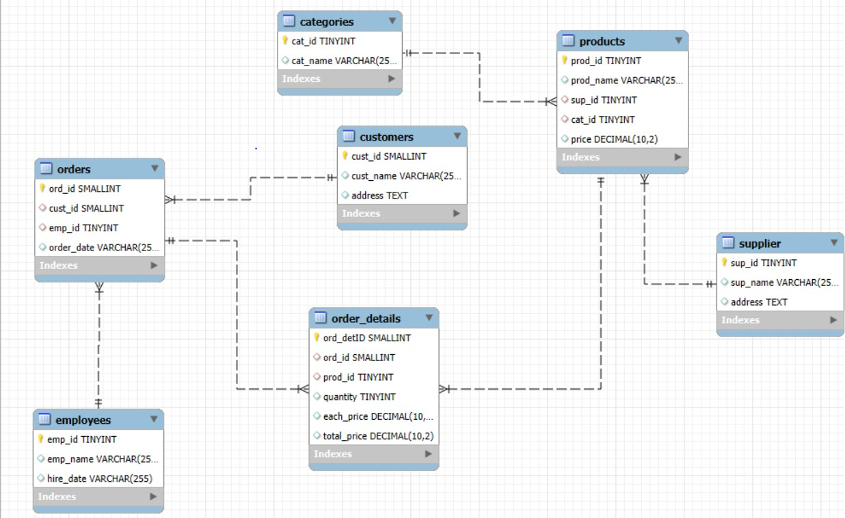
ER Diagram

Slide 7
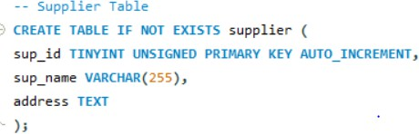
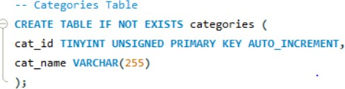
DDL - Creating Table Structures
Creating our DB —>
Creating Supplier Table —>
Creating Categories Table —>

Slide 8
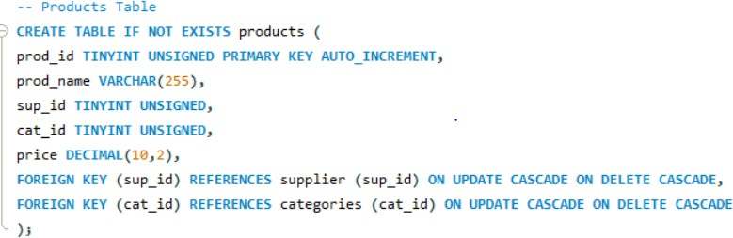
DDL - Creating Table Structures (Contd.)
Creating Products Table —>

Slide 9
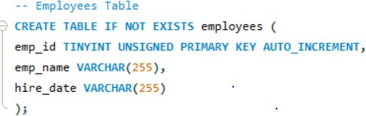
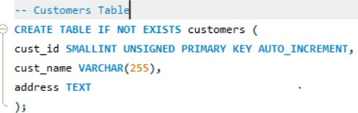
DDL - Creating Table Structures (Contd.)
Creating Employees Table —>
Creating Customers Table —>

Slide 10
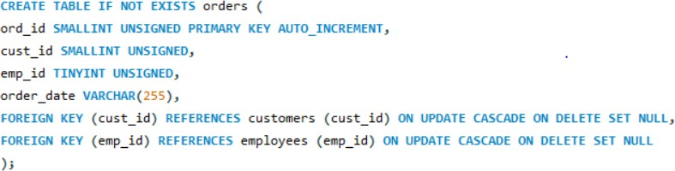
DDL - Creating Table Structures (Contd.)
Creating Orders Table —>

Slide 11
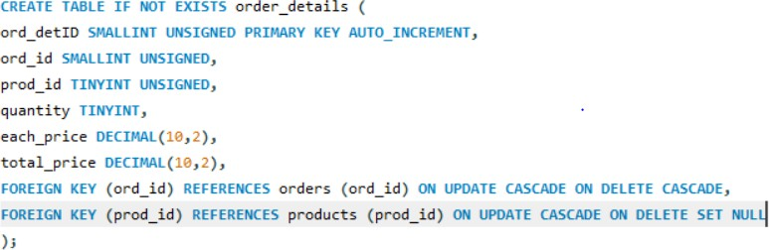
DDL - Creating Table Structures (Contd.)
Creating Order Details Table —>

Slide 12
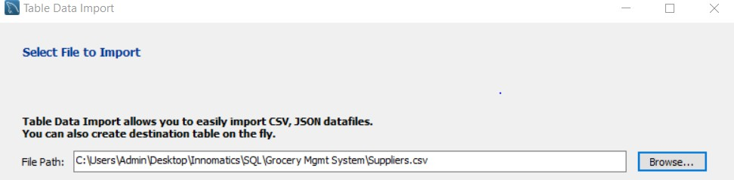

DML - Inserting Data into Tables
Suppliers.csv —> Categories.csv —> Products.csv —> Store_Employees.csv —> Customers.csv —> Orders.csv —> OrderDetails.csv —>

Slide 13
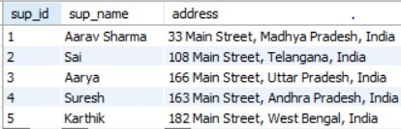


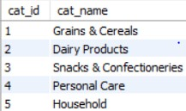
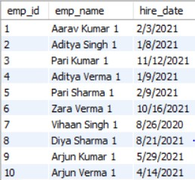
Quick Overview of the Data (Contd.)
Supplier Products
Categories
Employees

Slide 14






Quick Overview of the Data (Contd.)
Customers Order
Order Details

Slide 15


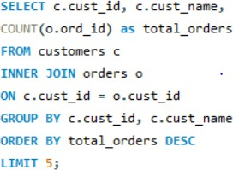
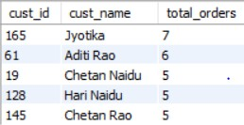
DQL - Customer Insights
How many unique customers have placed orders?
Which customers have placed the highest number of orders?

Slide 16
DQL - Customer Insights
How many unique customers have placed orders?
Which customers have placed the highest number of orders?

Slide 17
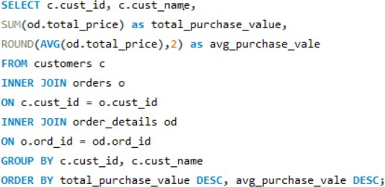
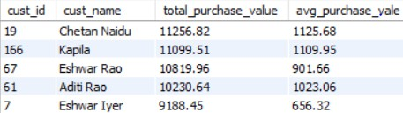
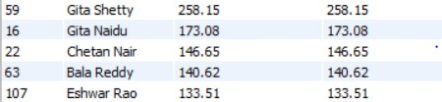
DQL - Customer Insights(Contd.)
What is the total and average purchase value per customer?

Slide 18
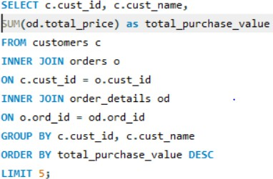
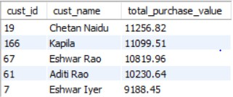
DQL - Customer Insights(Contd.)
Who are the top 5 customers by total purchase amount?

Slide 19
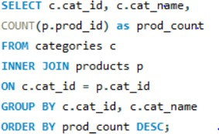
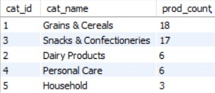
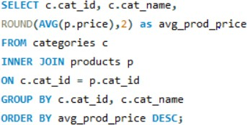
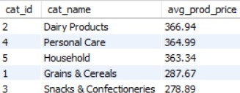
DQL - Product Performance
How many products exist in each category?
What is the average price of products by category?

Slide 20
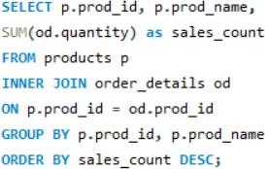
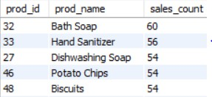
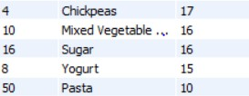
DQL - Product Performance (Contd.)
Which products have the highest total sales volume (by quantity)?

Slide 21
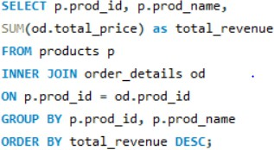
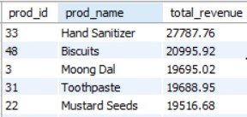
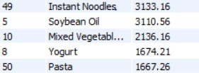
DQL - Product Performance (Contd.)
What is the total revenue generated by each product?

Slide 22
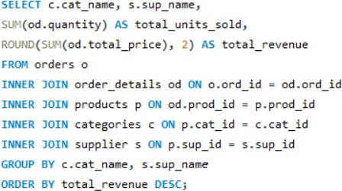
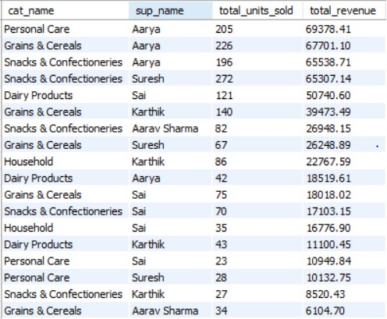
DQL - Product Performance (Contd.)
How do product sales vary by category and supplier?

Slide 23

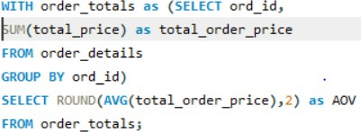

DQL - Sales and Order Trends
How many orders have been placed in total?
What is the average value per order?

Slide 24
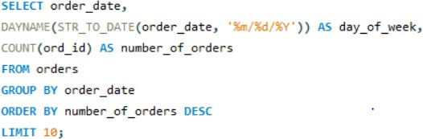
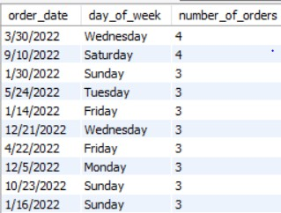
DQL - Sales and Order Trends(Contd.)
On which dates were the most orders placed?

Slide 25
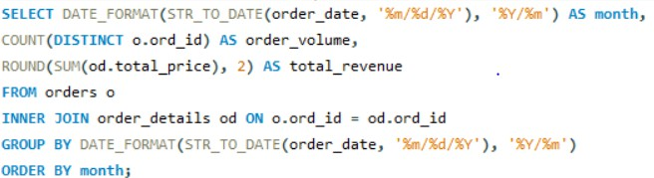
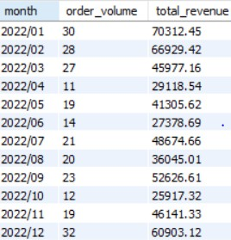
DQL - Sales and Order Trends(Contd.)
What are the monthly trends in order volume and revenue?

Slide 26
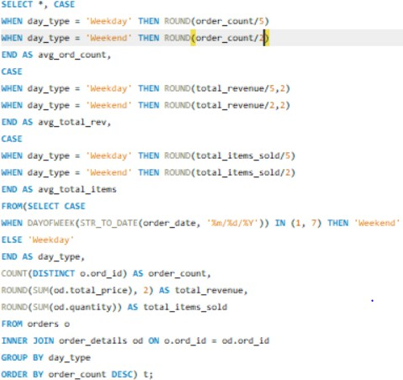

DQL - Sales and Order Trends(Contd.)
How do order patterns vary across weekdays and weekends?

Slide 27

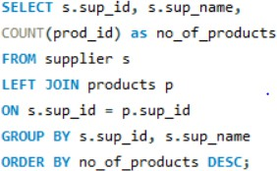
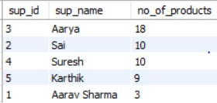
DQL – Supplier Contribution
How many suppliers are there in the database?
Which supplier provides the most products?

Slide 28
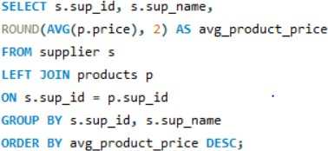
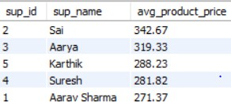
DQL – Supplier Contribution(Contd.)
What is the average price of products from each supplier?

Slide 29
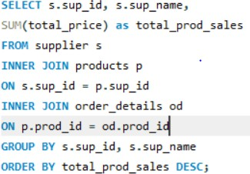
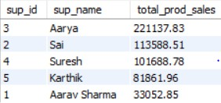
DQL – Supplier Contribution(Contd.)
Which suppliers contribute the most to total product sales (by revenue)?

Slide 30


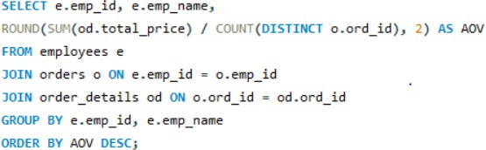
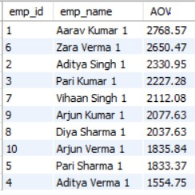
DQL – Employee performance
How many employees have processed orders?
What is the average order value handled per employee?

Slide 31
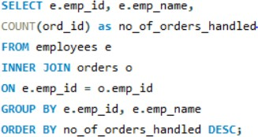
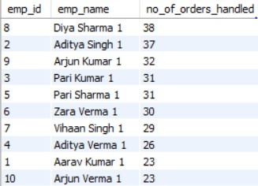
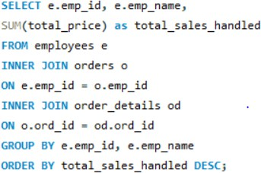
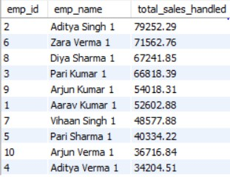
DQL – Employee performance (Contd.)
Which employees have handled the most orders?
What is the total sales value processed by each employee?

Slide 32


DQL - Order Details Deep Dive
What is the relationship between quantity ordered and total price?

Slide 33



DQL - Order Details Deep Dive(Contd.)
What is the average quantity ordered per product?

Slide 34


DQL - Order Details Deep Dive(Contd.)
How does the unit price vary across products and orders?

Slide 35
THANK YOU

